Slide 1

EMAIL SPAM DETECTION
USING MACHINE LEARNING
PROJECT 4 TEAM 13

Slide 2
OVERVIEW
Create a machine learning model that can identify if an email is spam or not, based on the words contained in the email
DATASET & DATA CLEANING
OPTIMIZATION ATTEMPT
CONCLUSION & RECOMMENDATION
01
03
05
02
04
INITIAL MACHINE LEARNING MODEL
OTHER ML MODELS
Notes:
Amir (30 SECS)
Short overview of what we’re going to talk about and the agenda

Slide 3
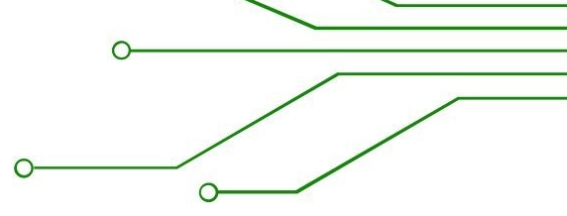

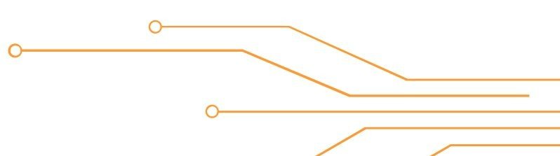
DATASET & DATA CLEANING
The dataset consists of over 5,000 emails. Each email was marked as either spam or not spam (ham).
Each of the words in the emails were counted and totalled, with each word as a separate feature.
Words that appeared less than 50 times in the entire set of emails were dropped as unnecessary.
Notes:
Arzan (1 MIN)
Data cleaning, why is it important,

Slide 4
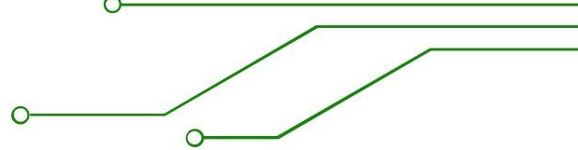

INITIAL MACHINE LEARNING MODEL
Confusion Matrix:
Layers & Nodes
Layer 1: 4,400 nodes
Layer 2: 2,200 nodes
Total parameters: 19,302,801
Epochs: 10
TN: 866
FP: 43
FN: 10
TP: 374
ACCURACY: 0.9420
PRECISION: 0.8590
RECALL: 0.9430
F1 SCORE: 0.8902
Notes:
Sam (2 MIN)
What options did we pick for our initial model

Slide 5
OPTIMIZING OUR MODEL
Layers & Nodes:
Layer 1: 1000
Layer 2: 2000
Layer 3: 3000
Layer 4: 4000
Total Parameters: 22,199,001
Epochs: 20
ACCURACY: 0.97
PRECISION: 0.9141
RECALL: 0.9727
F1 SCORE: 0.9385
Notes:
Arzan (2 MIN)
What types of methods did we use to optimize the model

Slide 6
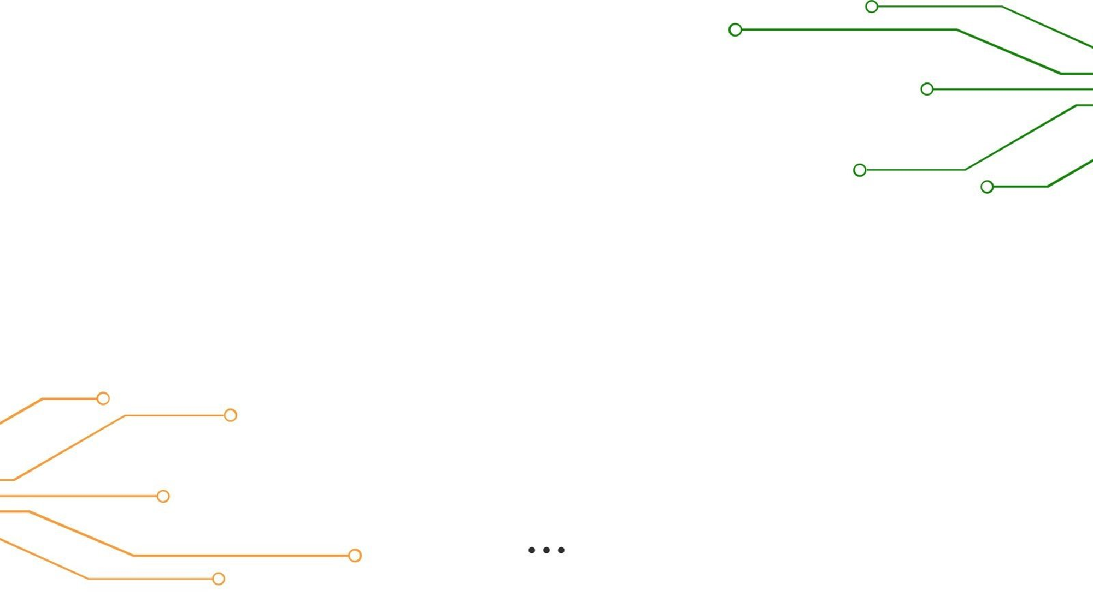
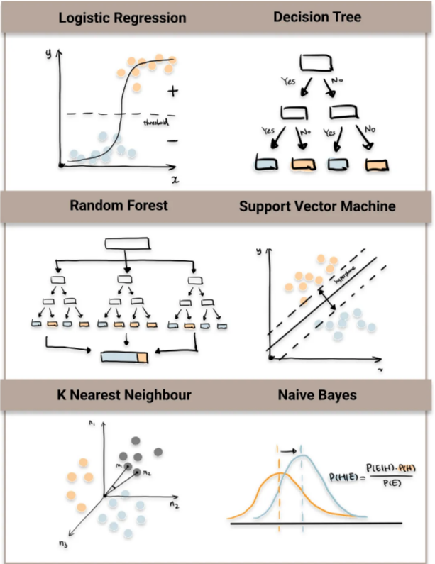
OTHER MACHINE LEARNING MODELS
LOGISTIC REGRESSION
DECISION TREE
RANDOM FOREST
SVM MODEL
K-NEAREST NEIGHBOUR
NAIVE BAYES
Notes:
Prabha (2 MIN)
Description of each model and what the differences are between them

Slide 7
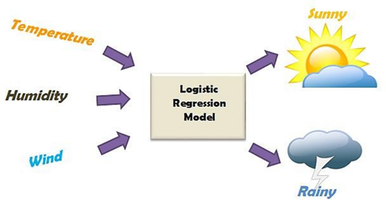
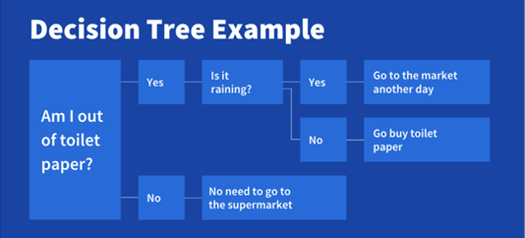

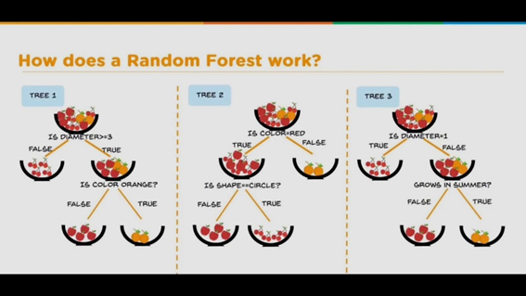
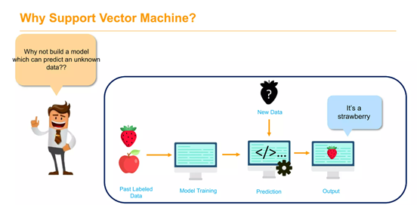
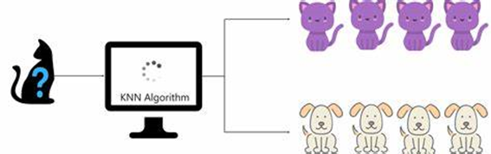
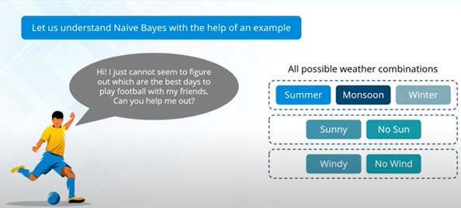
Notes:
Cont. Prabha

Slide 8
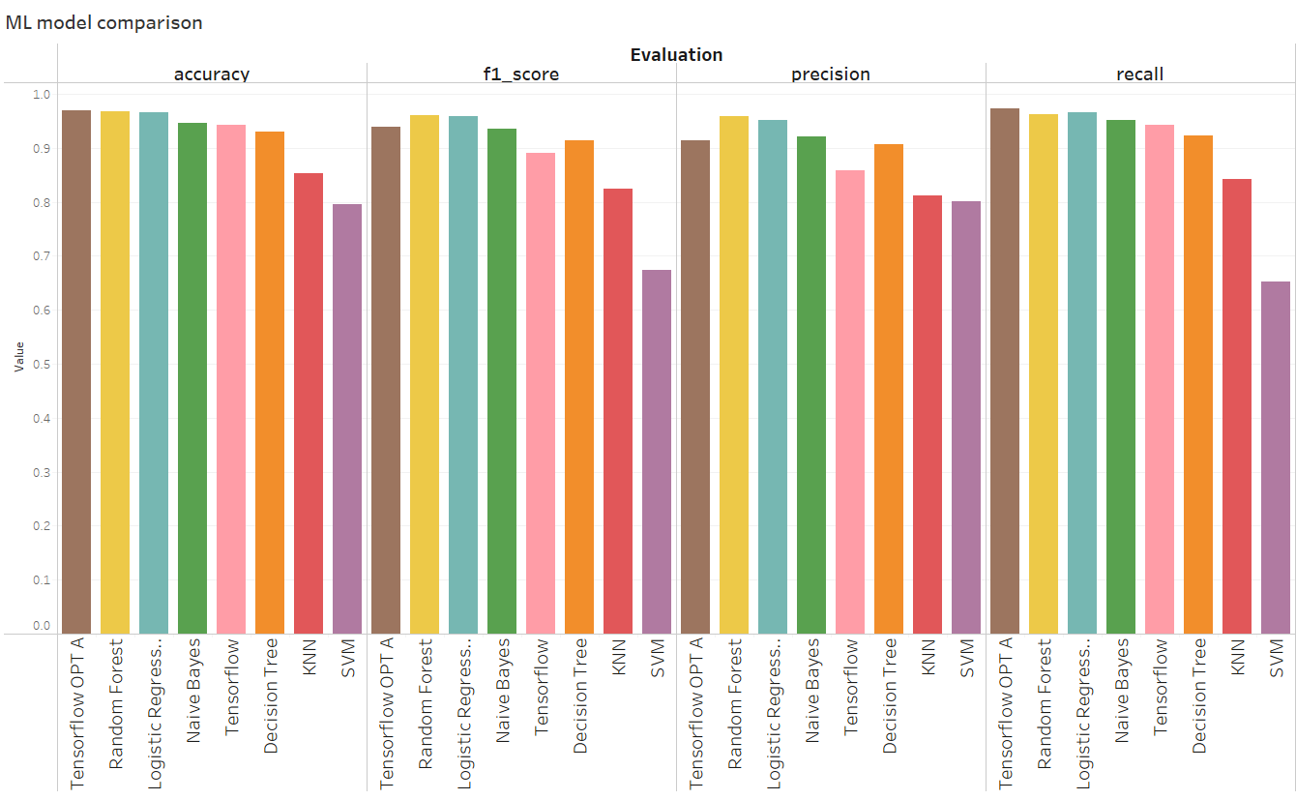
CONCLUSION & RECOMMENDATION
WINNER: Random Forest
Notes:
Amir (1 MIN)
Which model did we choose and why

Slide 9

THANK YOU
QUESTIONS?

